Slide 1

Python & Data Science Training Project 3 – Home Price Changes in Southern California

Slide 2
Purpose of the Study
This project will do the following:
Impact of interest rate on mortgage originations?
Impact of interest rate on home prices?
Tracking home price changes in southern California for four years (2018/01 to 2021/12).

Slide 3
Link to the file for the project
- Program 4.1 will process 55GB of data and requires a lot of computing power.
- If your computer is not powerful to run 4.1 of the Jupyter Notebook, you can skip 4.1 and directly use 4.2 after downloading the zipped data from the following link:
https://1drv.ms/u/s!Amfo1lixPzv-j3d8Ft7z2lWyGMwq?e=vChMsW
There are 18 files after you have unzipped it. 16 files are mortgage origination files from 2018/01 to 2021/12.

Slide 4
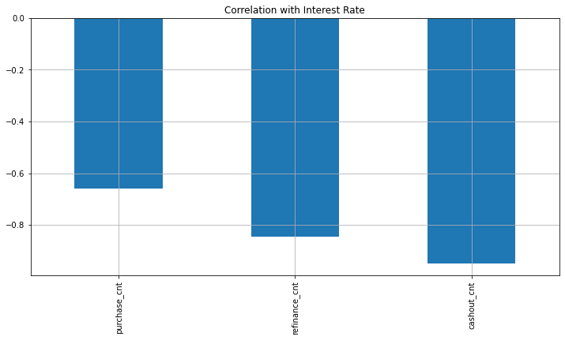
We will compare loan quality in the following aspects
FICO score
Loan Purpose
Purchase (less sensitive to interest changes. 刚需）
Relocation to a new place
Getting married
Rate refinance (very sensitive to interest rate)
When interest rate drops, a refinance can low down mortgage payment.
Cash out refinance (very sensitive to interest rate)
Example: A house of $1mm with $600 in unpaid principal (loan amount).
The borrower can get $50K from the bank to finance remodeling.
His/her new unpaid principal is now $650K.
Interest only loans (no payment for principal)
LTV (loan-to-value ratio)
LTV=loan amount / house selling value
DTI (debt-to-income ratio)
DTI=debt payment /Income

Slide 5
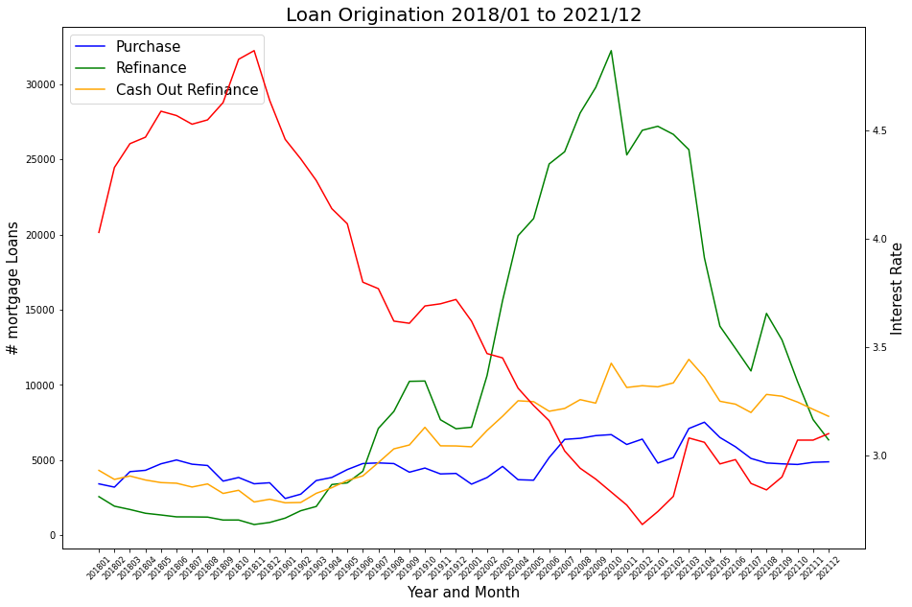
Example of visualization

Slide 6
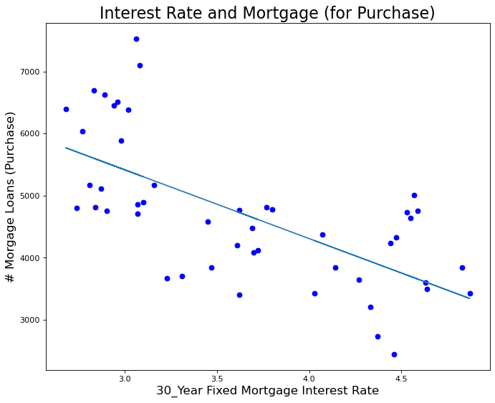
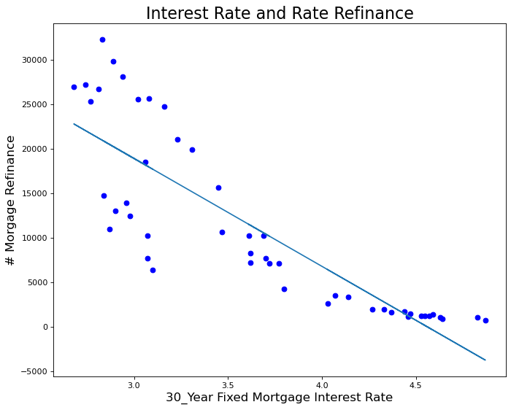
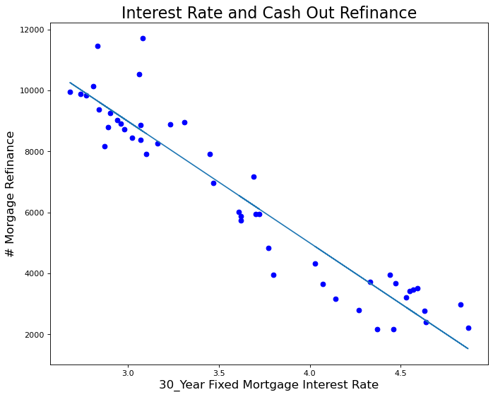
Example of visualization FICO and loan performance

Slide 7
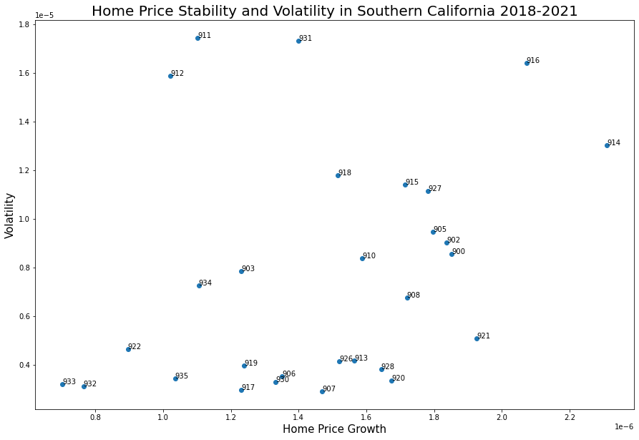
Example of visualization
Each data point on the graph is labeled by the first 3 digits of the zip codes in southern California.

